Slide 1
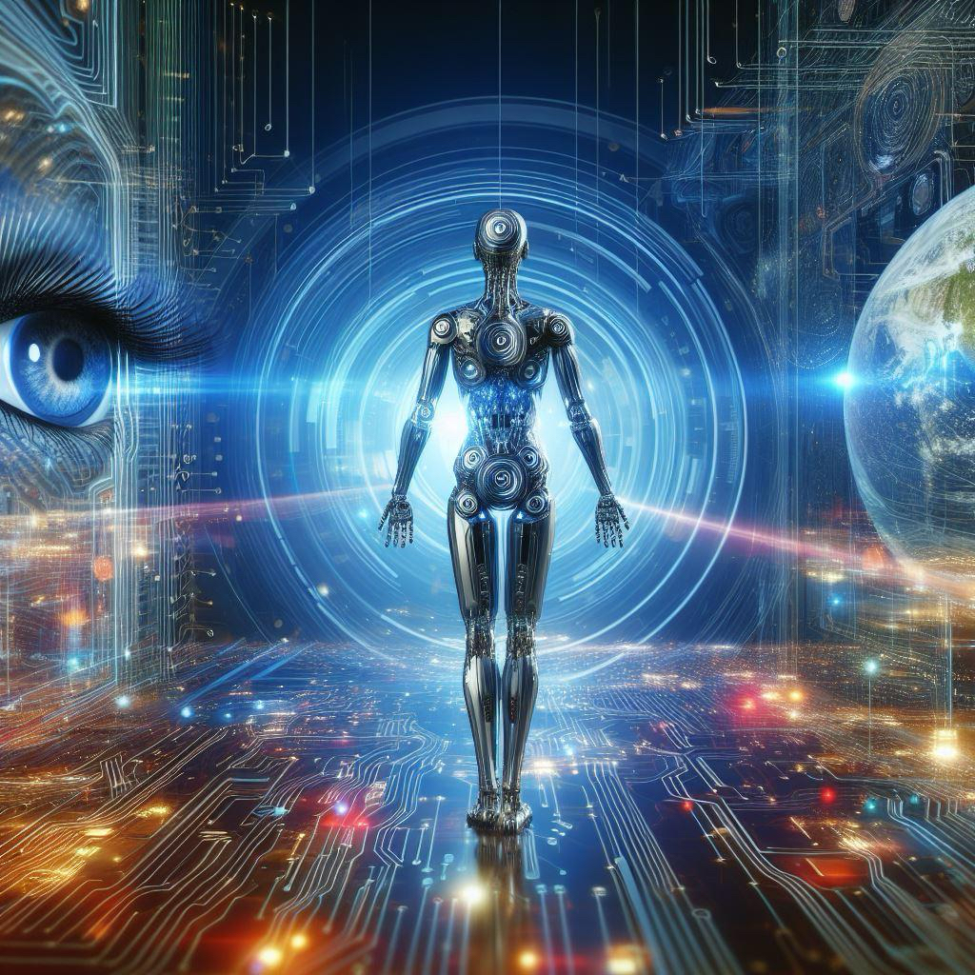
Exploring the World of Computer Vision: A Portfolio of Learning

Slide 2
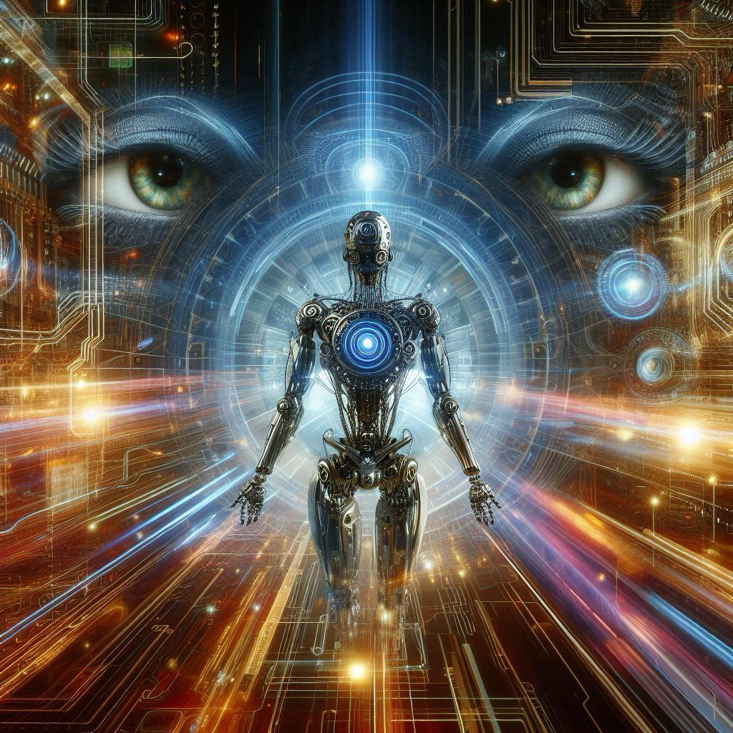
Introduction
Welcome to Chuck’s Computer Vision AI Course Portfolio, where I embark on a captivating journey through the realm of computer vision and artificial intelligence. Throughout this course, I have delved into various modules, each offering unique insights and practical exercises aimed at honing my skills and understanding in the dynamic field of computer vision.

Slide 3
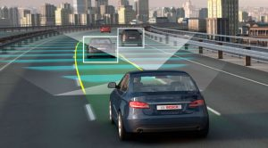
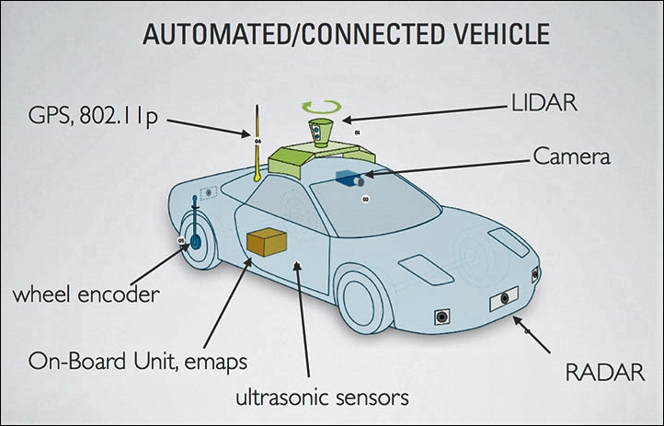
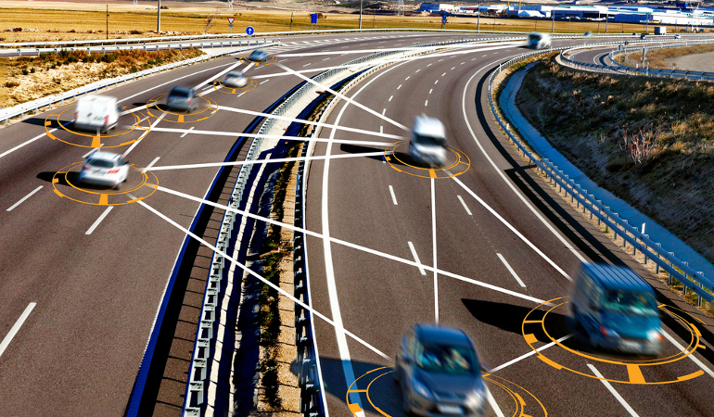
ComputerVisionApplication
AUTONOMOUS VEHICLES
interpret and analyze real-time visual data from their surroundings, enabling them to perceive and navigate complex environments with precision and adaptability. By integrating advanced algorithms for object detection, recognition, and path planning, these vehicles can make intelligent decisions and safely maneuver on roads without human intervention.

Slide 4

GITHUB
Git allows the creation of branches to work on features or fixes independently, and later merge them back into the main codebase.
Code cells are where you write and execute code. They allow you to run and test snippets of code in the notebook
To execute the code within a code cell, you can use the "Run" button in the toolbar, press Shift+Enter, or use other keyboard shortcuts. The output of the code, such as printed values or plots, is displayed below the code cell.
Markdown cells contain text and can include formatted text, images, hyperlinks, and more

Slide 5

Exploring Jupyter Notebooks
Jupyter Notebook is an open-source web application that allows you to create and share documents containing live code, equations, visualizations, and narrative text. It supports various programming languages, including Python, R, and Julia, making it a versatile tool for data analysis, machine learning, and scientific research.
Here's how Jupyter Notebook works:
Interactive Environment: Jupyter Notebook provides an interactive environment where you can write and execute code in individual cells. Each cell can contain code, text (in Markdown format), or visualizations.
Code Execution: You can write code in a cell, such as Python code for data analysis or machine learning algorithms. When you run a code cell, the code is executed by the kernel associated with the notebook. The kernel processes the code and returns the output, which can include numerical results, plots, or error messages.
Kernel: The kernel is the computational engine that executes the code written in the notebook. Each notebook is associated with a specific kernel, which determines the programming language and environment used for code execution. You can switch kernels within a notebook to work with different languages or environments.
Live Output: The output generated by code cells, such as printed values, plots, or interactive widgets, is displayed directly below the corresponding code cell. This live output allows you to see the results of your code immediately and iteratively refine your analysis or algorithms.
Narrative Text: In addition to code cells, you can include narrative text in Markdown cells to provide explanations, documentation, or context for your code. Markdown cells support formatting options such as headings, lists, links, and images, allowing you to create rich, readable documents.

Slide 6
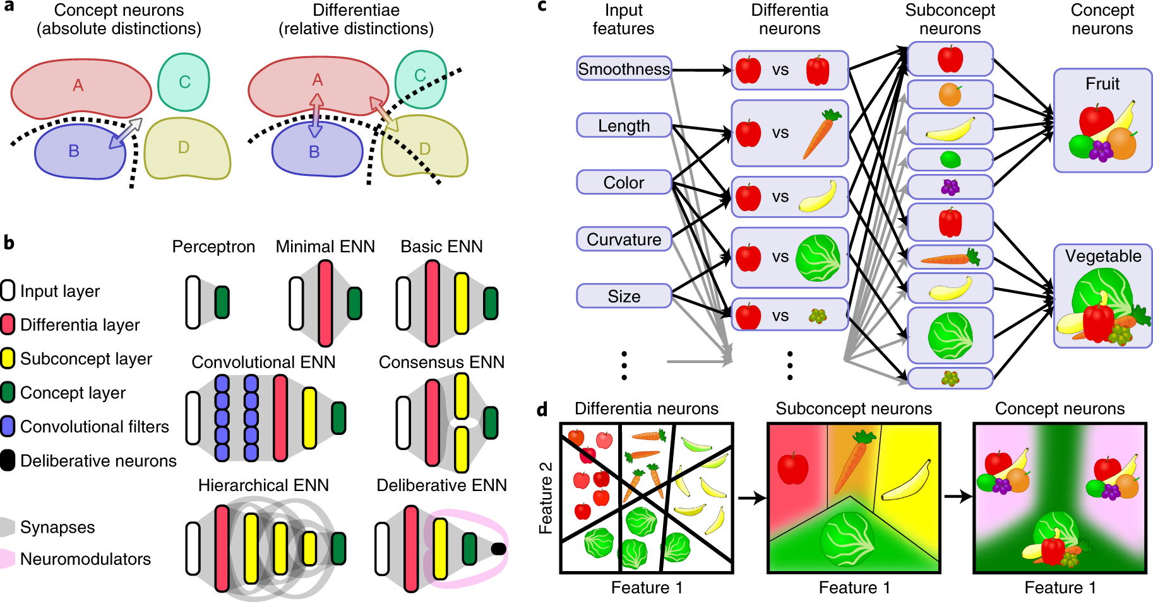
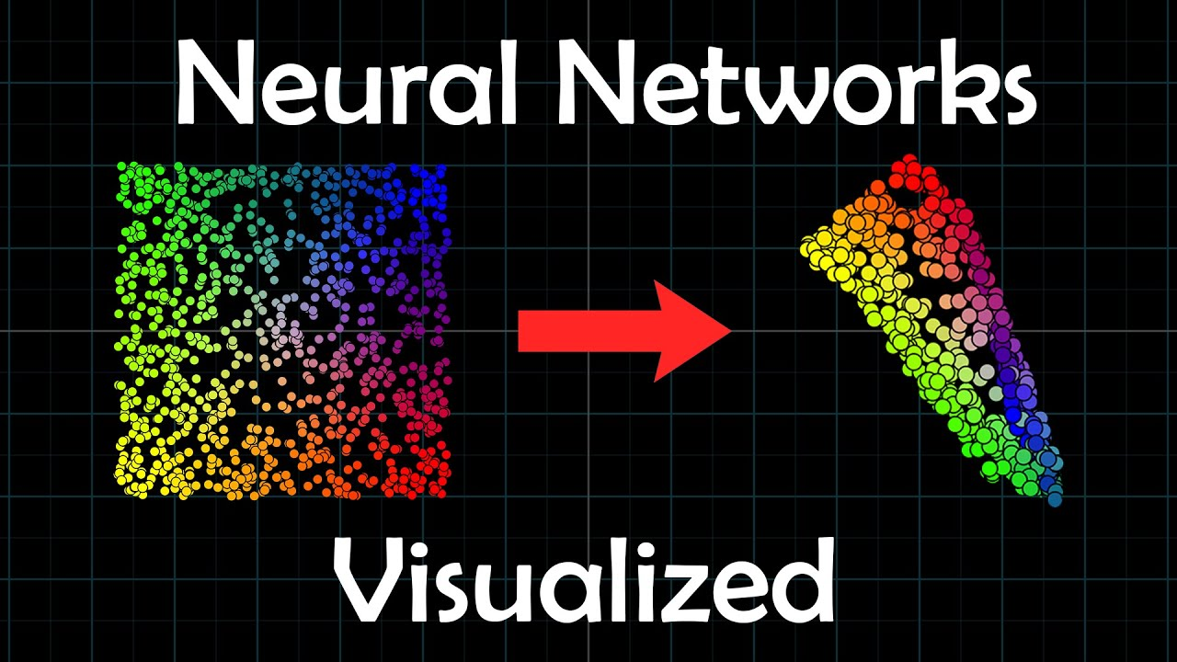
Introduction to Neural Networks
1.Neural Network Structure: Comprised of interconnected nodes in layers, neural networks utilize activation functions and parameters to influence behavior.
2. Activation Functions: Experimentation favored ReLU over sigmoid due to faster convergence and superior performance.
3. Hidden Layer Neurons: Increasing neurons improved pattern learning but risked overfitting; additional layers allowed hierarchical data representation but required careful tuning.
4. Learning Rate: Adjusting the learning rate affected convergence speed and accuracy, with higher rates risking overshooting and lower rates providing better stability.
5. Data Noise: Introducing noise hindered performance, with higher levels leading to decreased accuracy and increased overfitting.
6. Dataset Exploration: Simple datasets achieved higher accuracy and faster convergence compared to complex ones.

Slide 7

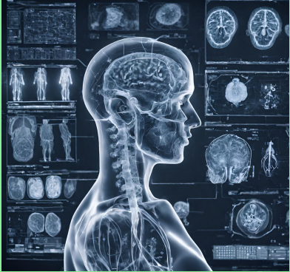
REVOLUTIONZING MEDICAL IMAGING
With Computer Vision (CV), machines are
able to interpret visual data just like the
human eye, if not better. In medical
imaging, this means dramatically enhancing
the precision of image analysis in X-rays,
MRI, and CT scans, setting a new benchmark
for diagnostic accuracy and treatment
efficacy.
Envision a world where medical
diagnoses overcome current
limitations, becoming faster, more
accurate, and universally accessible.
Through the lens of Computer Vision,
we are building it today

Slide 8
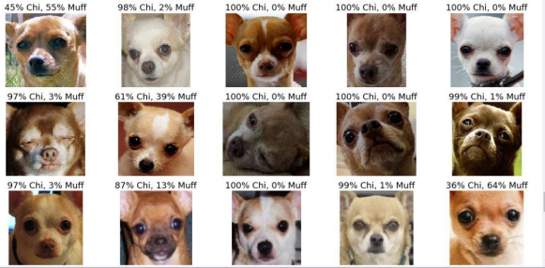
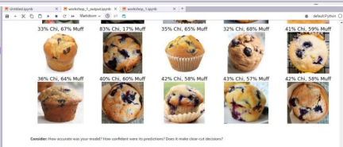
Chihuahua or Muffin
Visual Perception Challenges: The task highlighted the challenges of visual perception, as distinguishing between visually similar objects (Chihuahua dogs and muffins) can be surprisingly difficult for both humans and machine learning algorithms.
Feature Extraction: You gained insight into the importance of feature extraction in image classification tasks. Identifying relevant features, such as shape, texture, and color, is crucial for accurately distinguishing between different classes of objects.
Machine Learning Evaluation: Through the task, you likely gained experience in evaluating the performance of machine learning algorithms. This may involve metrics such as accuracy, precision, recall, and F1-score, which provide quantitative measures of a model's effectiveness in classification tasks.
Bias and Generalization: The task may have also highlighted the concept of bias in machine learning, as algorithms can be prone to biases based on the training data they are exposed to. Additionally, the task may have underscored the importance of generalization, as machine learning models should be able to accurately classify unseen examples beyond the training dataset.
Human-Machine Interaction: Finally, the task may have sparked reflection on the interaction between humans and machine learning systems. Understanding the limitations and capabilities of AI algorithms can inform how humans interact with and interpret the outputs of these systems in various applications.

Slide 9
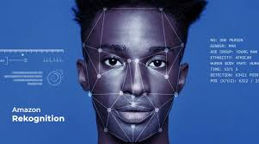
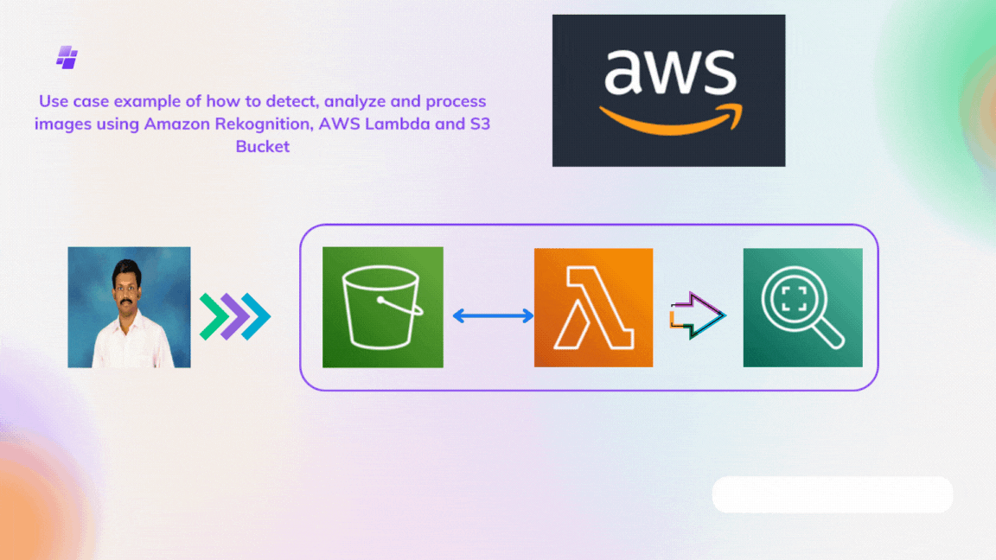
Amazon Rekognition
Amazon Rekognition offers a range of functionalities, including facial analysis, object and scene detection, text recognition, and even celebrity recognition. These capabilities enable applications in various real-world scenarios, such as law enforcement for identifying suspects or missing persons, retail for personalized marketing, and content moderation on social media platforms.
However, the use of facial recognition technology like Amazon Rekognition also raises significant ethical considerations. Privacy concerns emerge regarding the collection and use of individuals' biometric data without their explicit consent. Moreover, the potential for biased outcomes, particularly in law enforcement applications, poses risks of perpetuating systemic injustices.
The workshop provided a hands-on experience that deepened our understanding of AI and machine learning. By experimenting with Amazon Rekognition's features, we gained insights into the underlying algorithms and the importance of data quality in training models. Additionally, the workshop highlighted the potential limitations and challenges in deploying AI solutions, such as model accuracy and interpretability.
Reflection:
The presentation and workshop challenged our preconceptions about AI technologies, revealing both their capabilities and limitations. While we recognized the transformative potential of Amazon Rekognition in enhancing efficiency and innovation across various industries, we also became more attuned to the ethical implications of its widespread adoption.
The potential impacts of Amazon Rekognition on society are profound and multifaceted. On one hand, it offers opportunities for enhanced security, customer experience, and accessibility. On the other hand, it amplifies existing concerns related to privacy, discrimination, and surveillance. As stewards of technological advancement, we must navigate these complexities responsibly and advocate for ethical AI practices.

Slide 10
Thank you
Reference
https://aws.amazon.com/rekognition/
CHATGPT
Chuck D. sonujain@contoso.com www.contoso.com

